Slide 1
SUSPENSION SYSTEM IN A CAR
Prepared by :
K.SATISH

Slide 2
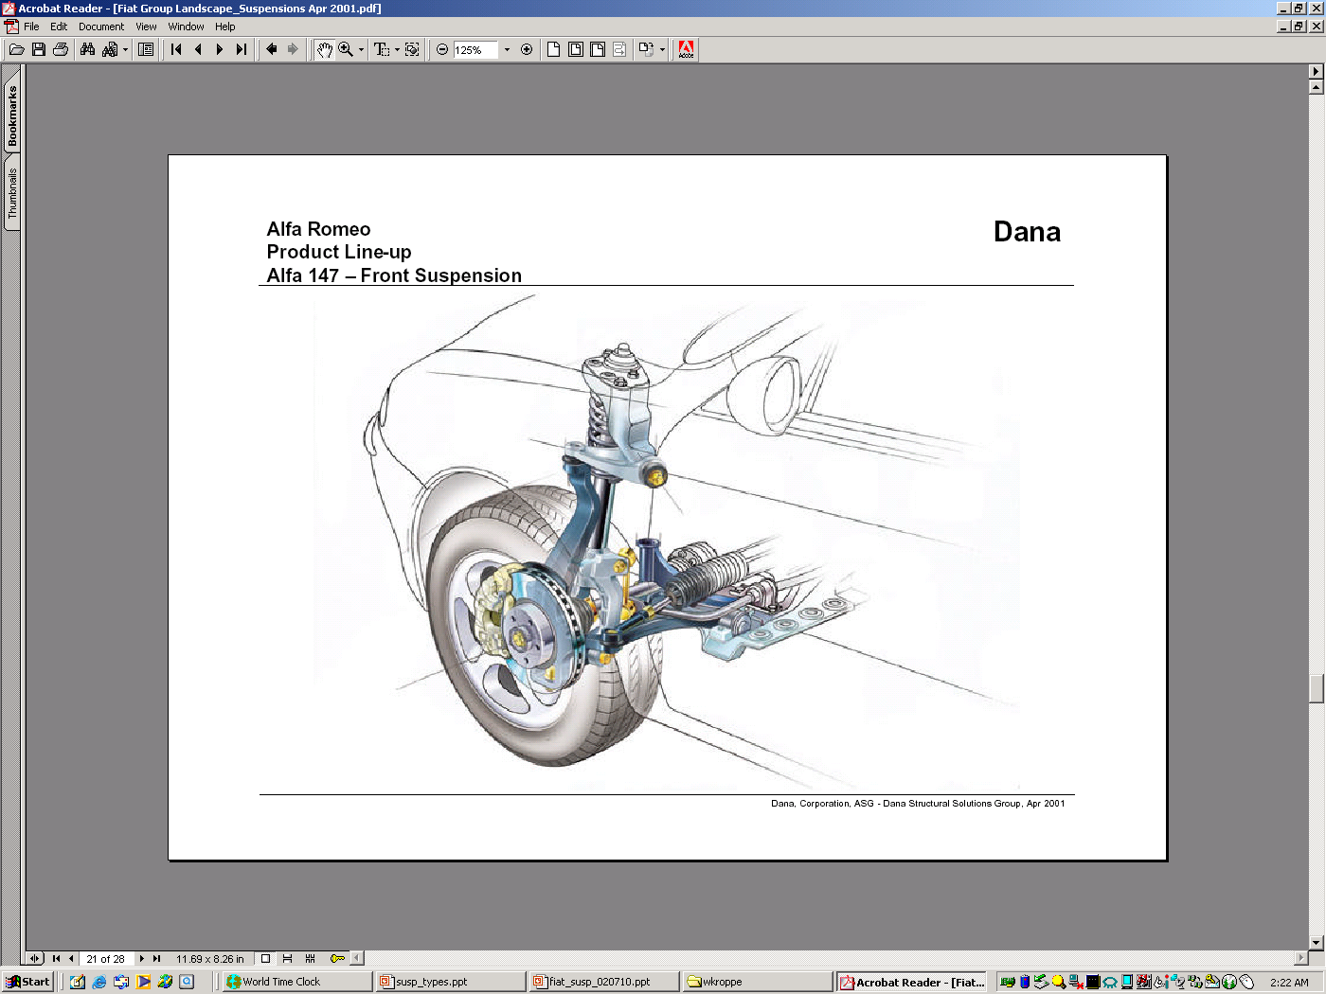
Suspension system in automobiles

Slide 3
What is suspension system
Suspension is the term given to the system of springs, shock absorbers and linkages that connects a vehicle to its wheels
Serve a dual purpose – contributing to the car's handling and braking.
Protects the vehicle itself and any cargo or luggage from damage and wear

Slide 4
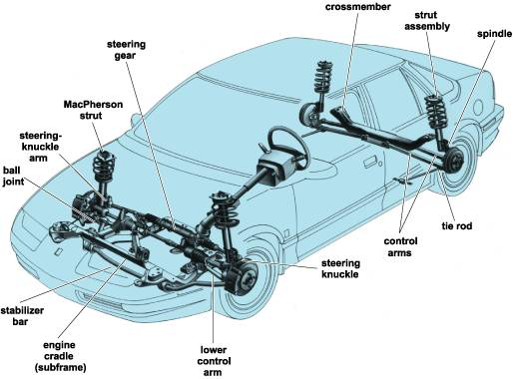
SUSPENSION SYSTEM – LAY OUT

Slide 5
Different suspension systems
Conventional suspension system
Independent suspension system
Air suspension system
Hydro elastic suspension system

Slide 6
Conventional suspension system
Two wheels are mounted on either side of the rigid axle
When one wheel encounters the bump, both the wheel do not execute parallel up and down motion
So it gives rise to gyroscopic effect and wheel wobble
Rear driving wheels mounted on live axle suspended by laminated leaf springs and shock absorbers

Slide 7
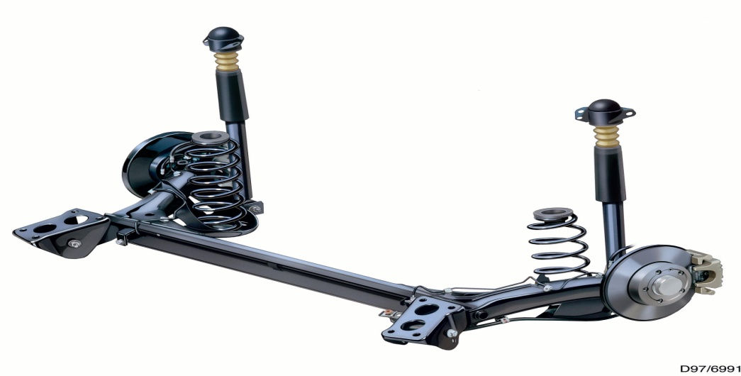
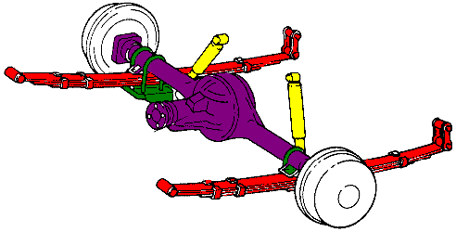
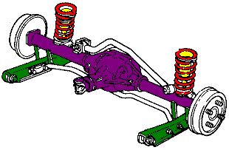

Slide 8
Independent suspension system
Both the front and the rear wheel are utilized
Design incorporated in the front wheels
One wheel goes down ,the other wheel does not have much effect
Basic classification of the design
MacPherson Strut
Double Wishbone
Multi link

Slide 9
Advantages ( independent front )
Bigger deflection of front wheels, no reaction on steering
Greater distance for resisting rolling action
Front axle (small-stub), improves road holding tendency of tyres.
Minimum vibrations
DISADVANTAGES
Better shock absorber required.
Expensive
Tyre wear increases due to transmission of torque.

Slide 10
Advantages ( independent rear suspension)
Lesser unsprung weight – improves ride , reduces tyre wear.
Increased passenger space
Rear wheels remain stable ..
DISADVANTAGES
Increased cost
Complicated design
Steering action is not proper

Slide 11
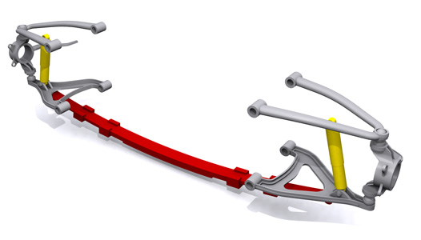
Traverse suspension system

Slide 12
Normally find on the rear suspension
Combines independent double wishbone suspension with a leaf spring.
It involves one leaf spring mounted across the vehicle, connected at each end to the lower wishbone.
The centre of the spring is connected to the front subframe in the middle of the car.
There are still two shock absorbers, mounted one to each side on the lower wishbones.

Slide 13
Air suspension
Comprises of compressor , suppling air to air tank
Pressure maintained – 5.6 to 7 kg/sq.m
Air bags – on each wheel
As load applied , air bags compressed actuating the levelling valve .
Air from the tank fills the compressrd air bag & hence raise the level of the frame.
Air from air bag gets released as load on chassis decreases .

Slide 14
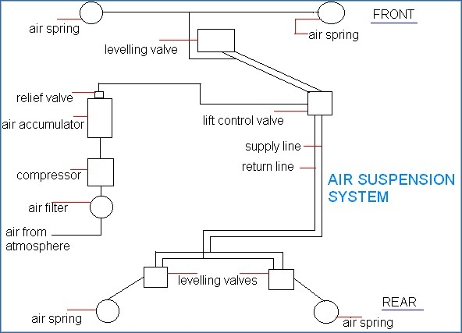
Air suspension layout

Slide 15
Advantages of air suspension
These maintain a constant frequency of vibration whether the vehicle is laden or unladen.
Constant frame height is maintained.
It helps to reduce the load while the vehicle in motion i.e. the dynamic loading as the spring rate variation between laden and unladen weight is much less.
It gives smooth and comfort ride of the vehicle.
The stiffness of the system increases with the increase of the deflection.

Slide 16
Common Air Suspension Problems
Air bag or air strut failure
- due to old age, or moisture within the air system that damages them from the inside.
Compressor failure
- Primarily due to leaking air springs or air struts
- Compressor burnout may also be caused by moisture from within the air system coming into contact with its electronic parts.
Dryer failure
- which functions to remove moisture from the air system eventually becomes saturated and unable to perform that function

Slide 17
Hydrolastic Suspension
a system where the front and rear suspension systems were connected together in order to better level the car when driving.
The front and rear suspension units have Hydrolastic displacers, one per side.
These are interconnected by a small bore pipe. Each displacer incorporates a rubber spring
Damping of the system is achieved by rubber valves.

Slide 18
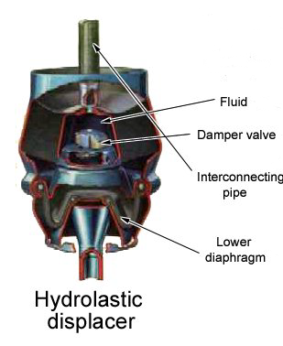
when the front wheel encounter bumps ,the piston moves upwards pressurising the fluid to enter into the rear unit.
Hydroelastic was eventually refined into Hydragas suspension.......

Slide 19
Hydrogas suspension
Known as hydro-pneumatic suspension.
The difference is in the displacer unit itself.
In the older systems, fluid was used in the displacer units with a rubber spring cushion built-in.
With Hydragas, the rubber spring is removed completely.
The fluid still exists but above the fluid there is now a separating membrane or diaphragm, and above that is a cylinder or sphere which is charged with nitrogen gas.
The nitrogen section is what has become the spring and damping unit whilst the fluid is still free to run from the front to the rear units and back.

Slide 20
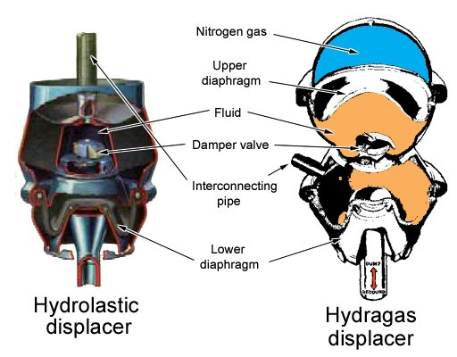
Difference …

Slide 21
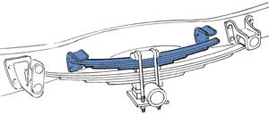
HELPER SPRING
DIRECTLY MOUNTED ON MAIN SPRINGS
TAKE CARE OF LARGE VARIATION IN SPRING LOAD
DURING LIGHT LOADS ,ONLY MAIN SPIRNG IS ACTIVE , AS LOAD INCREASE TO A PARTICULAR FIXED VALUE , BOTH THE SPRINGS ARE ACTIVE

Slide 22
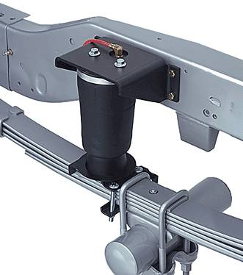
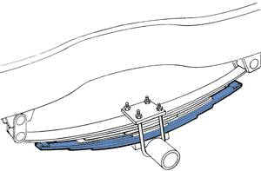
AIR ASSISTED HELPER SPRING
LEAF HELPER SPRING

Slide 23
THANK YOU

